Slide 1
Insuring Insurance Payments
Alex Domenick, Feng Zhang , Jeffrey Berger, Leith Bakhit, Umme Sadeka Arusha

Slide 2
Hypothesis
To define the optimal weighted portfolio and returns for Life Insurance companies to get a safe/adequate return to keep up with the rising death benefit payouts while still growing their AUM over time.
How could a Life Insurance company still increase their assets under management if their death claims doubled in 1 year or if a Pandemic caused a big increase in payouts over consecutive years?
What would happen to overall AUM if a large percentage of policies lapsed and payouts still increased?
Our models will show how a company can Insure their ability to pay out death claims even under unprecedented circumstances.

Slide 3
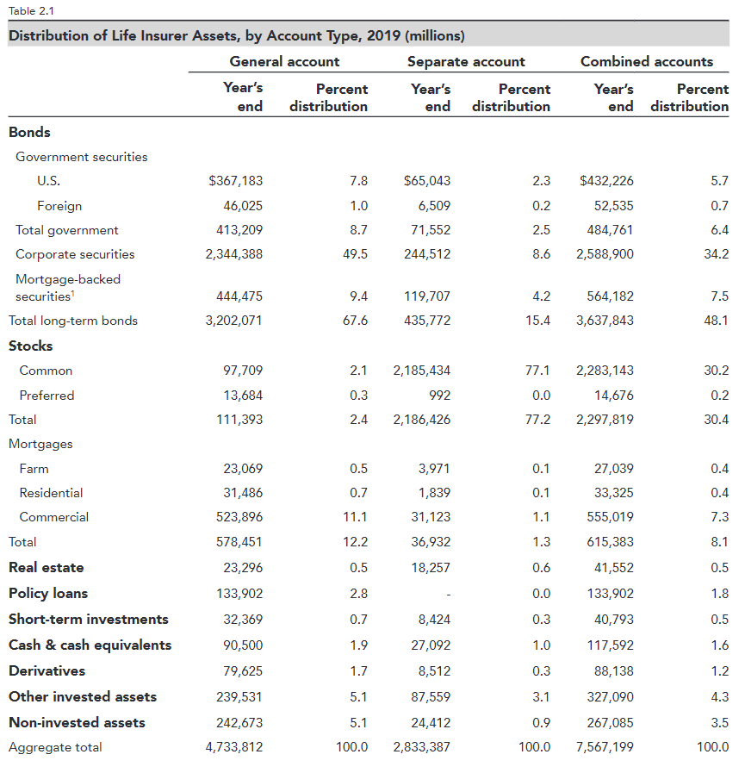
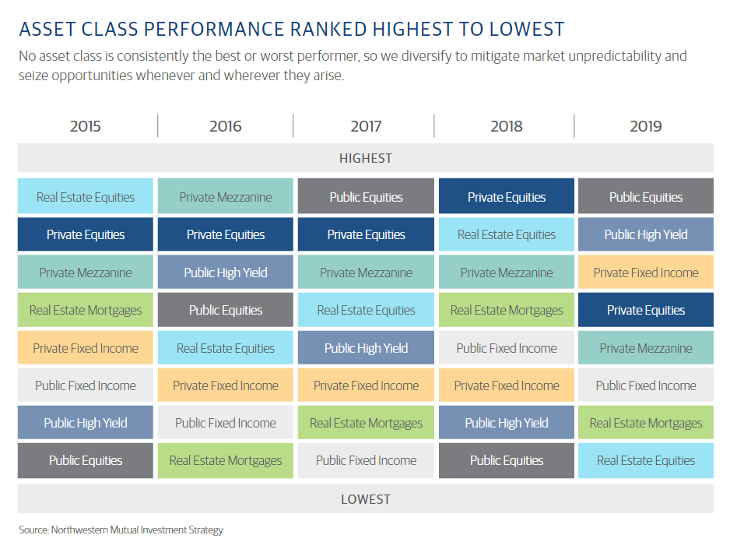
Sector/ETF Selection
Based on current life insurer assets allocation guidelines from “LIFE INSURERS FACT BOOK 2020” , we selected eight diversified sectors to build our portfolio.

Slide 4
Measuring Investment Risk
[Sharpe Ratio]
Why
Sharpe Ratio is used to determine whether the risk level of an investment.
We developed a module to calculate Sharpe Ratio of different ETFs based on historical data.
The result was used to determine which ETFs to choose from for the next step of the process.
How
To calculate the Sharpe Ratio, investors first subtract the risk-free rate from the portfolio’s rate of return, often using U.S.
Treasury bond yields as a proxy for the risk-free rate of return.
Then, we divide the result by the standard deviation of the portfolio’s excess return.
The exact formula for calculating the Sharpe Ratio is as follows:
Sharpe ratio = (Rp - Rf)/Std dev of excess return of the portfolio.
Rp = return of portfolio
Rf = return of risk free investment

Slide 5
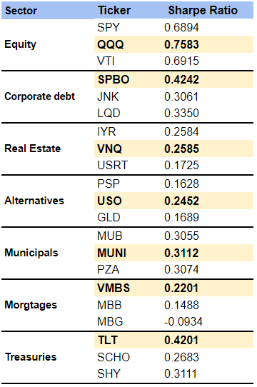
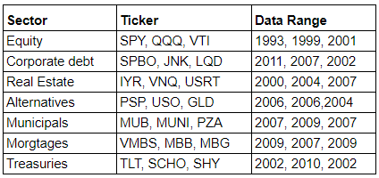
Data Preparation
Source: Alpaca
Unit: Daily
Range: 05/01/2011 - 01/19/2021

Slide 6
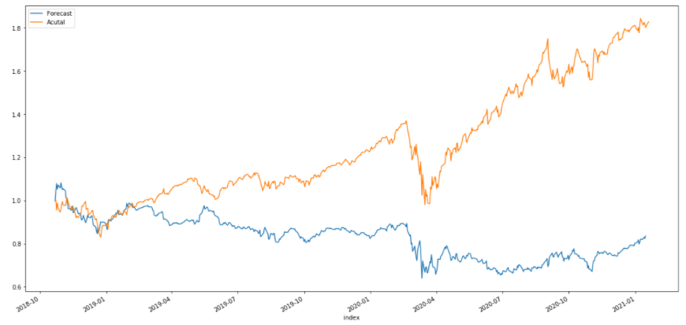
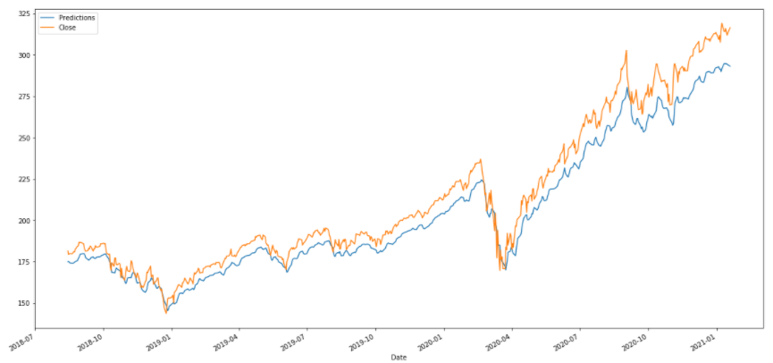
Model Choice
Model Choice
Random Forest
LSTM

Slide 7
Predicting Future Prices
Building a model
We looked at several different options for how to construct the model including using a random forest traditional Machine learning model and an LSTM Deep Learning model.
The LSTM Model is built using the closing prices of previous days as the only input for the model. We passed the data through one single layer and trained the model using 200 epochs and a lookback period of 45. This lookback period are the days that will be referenced by the model to forecast the future prices.
We analyzed the quality of the model by plotting the past, the Ground truth and the predicted prices on the same graph.

Slide 8
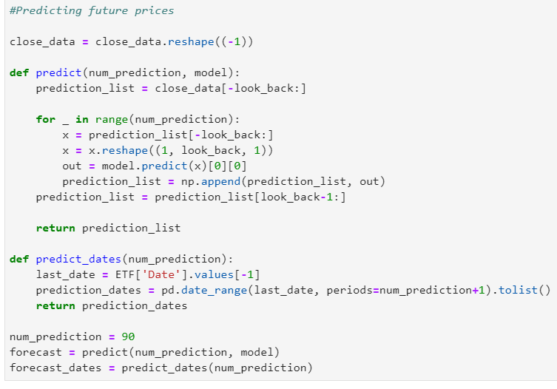
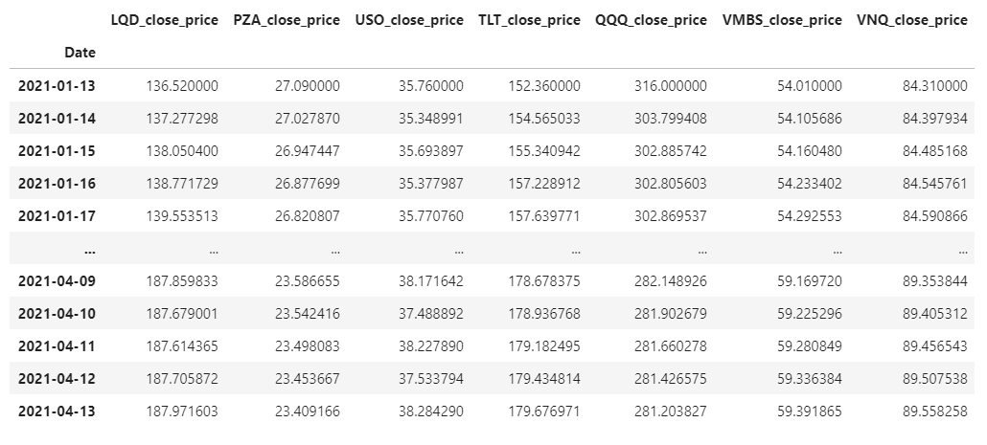
ETF Price Predictions based on LSTM Model

Slide 9
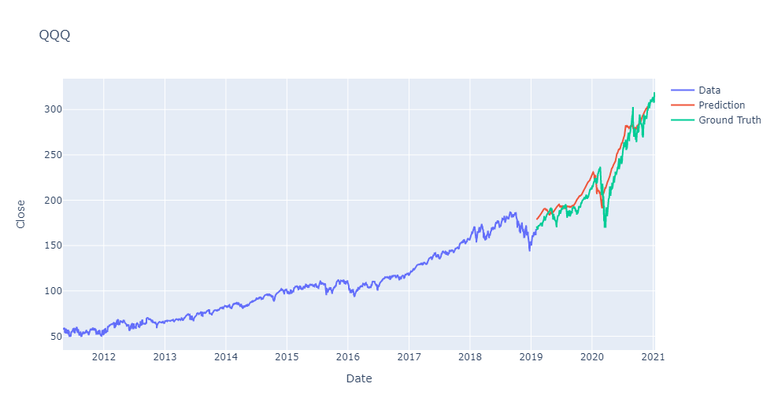
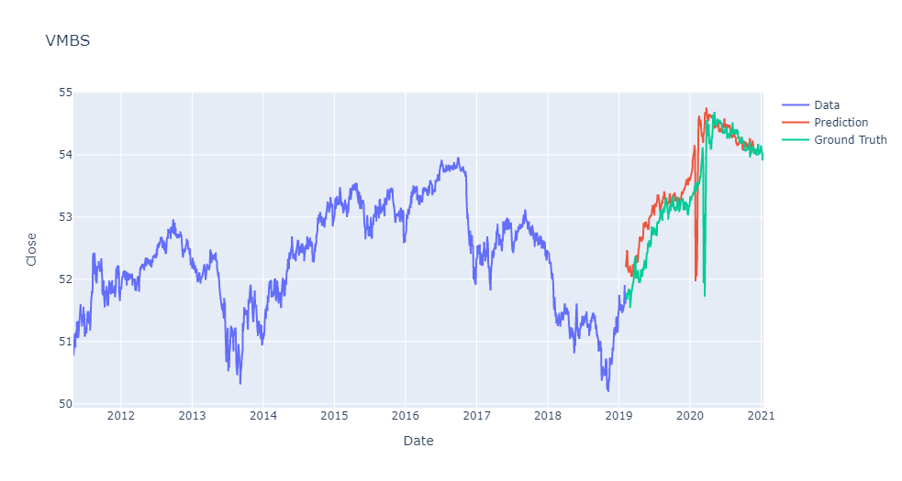
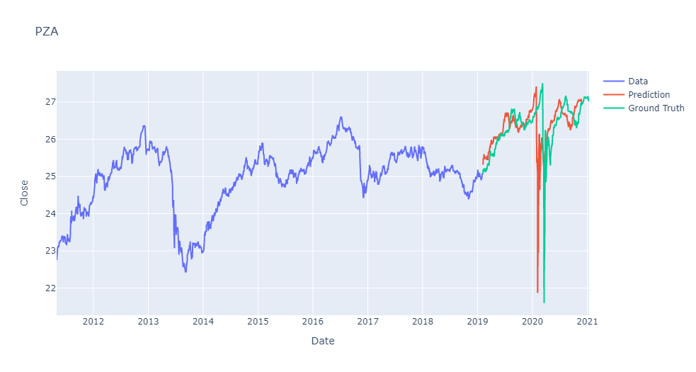
Plotting Predictions

Slide 10
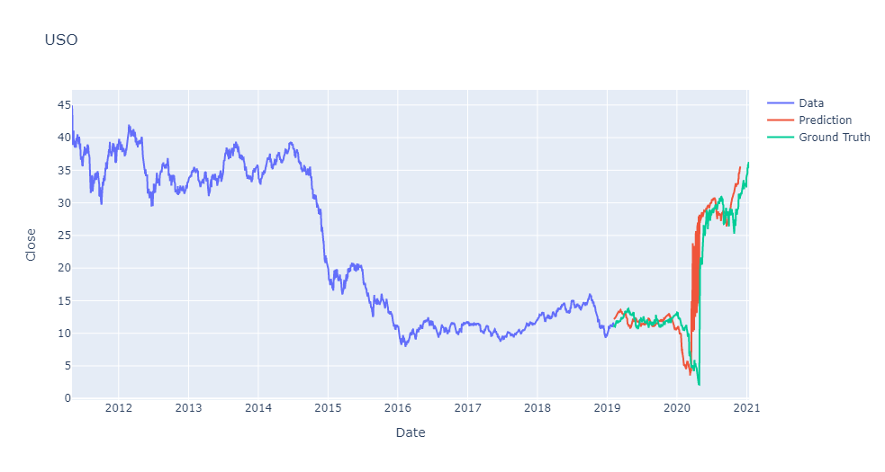
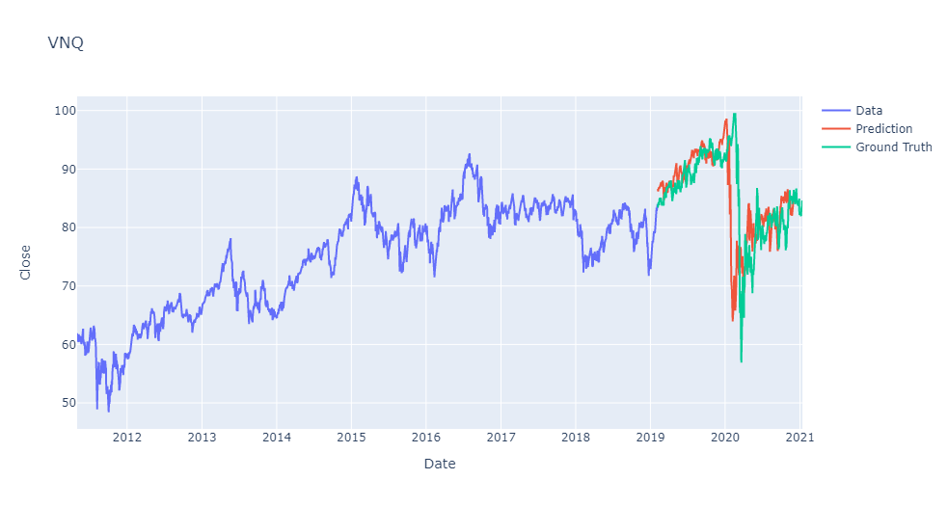
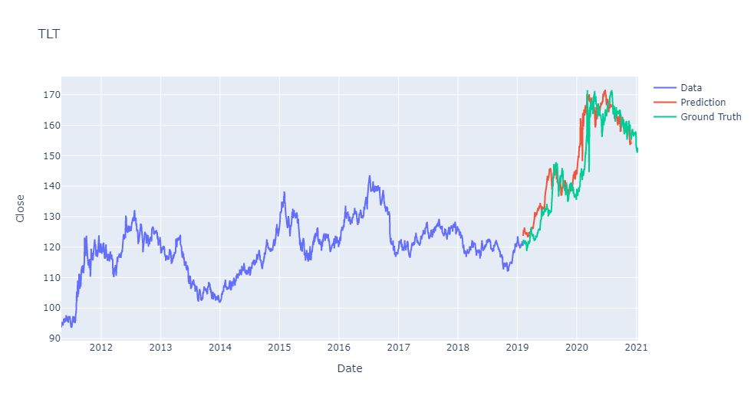
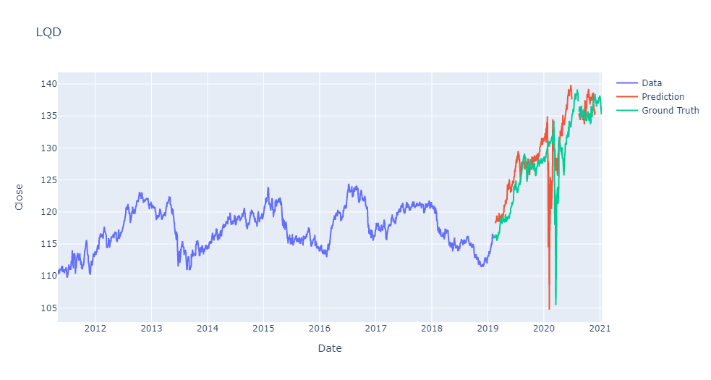

Slide 11
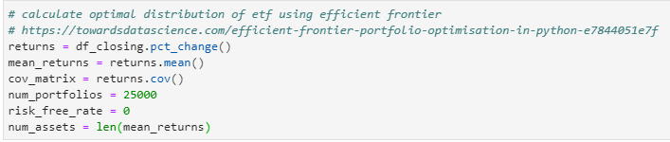
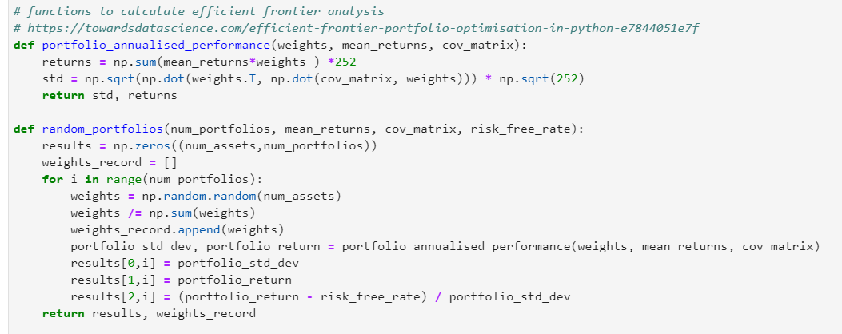
Portfolio Optimization

Slide 12
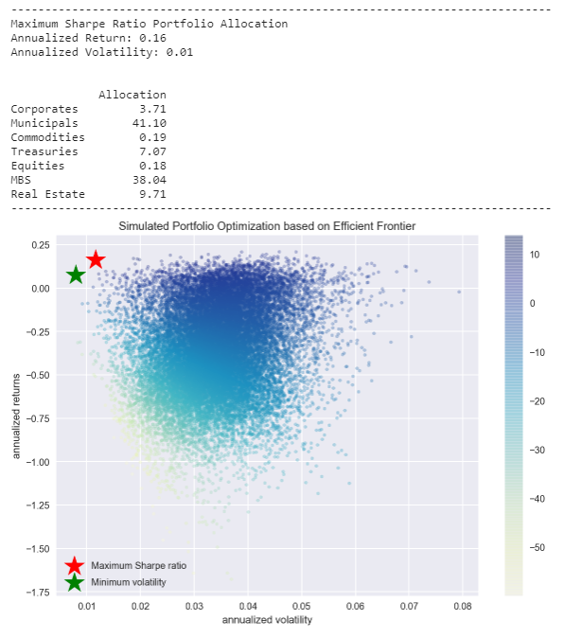
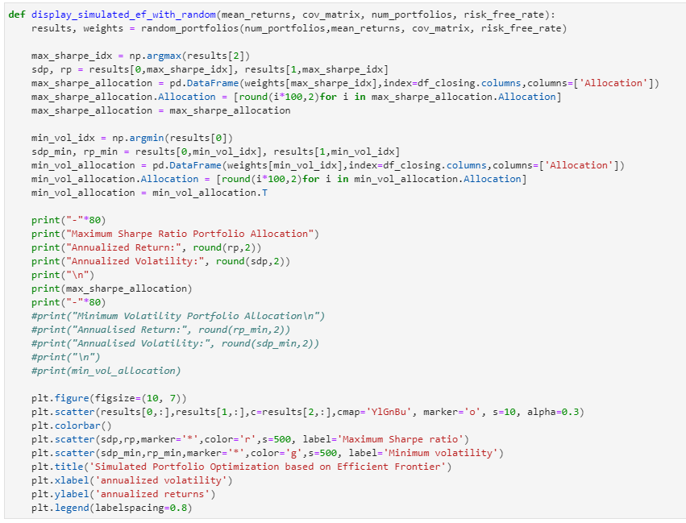
Efficient Frontier

